Slide 1
19CS3113S
Analysis and Design of Algorithms
Session -19

Slide 2
Dynamic programming
Well known algorithm design techniques:.
– Divide-and-conquer algorithms
• Another strategy for designing algorithms is dynamic programming.
– Used when problem breaks down into recurring small Subproblems
• Dynamic programming is typically applied to optimization problems. In such problem there can be many solutions. Each solution has a value, and we wish to find a solution with the optimal value

Slide 3
Dynamic programming
Dynamic Programming is a general algorithm design technique for solving problems defined by or formulated as
recurrences with overlapping sub instances.
Invented by American mathematician Richard Bellman in
the 1950s to solve optimization problems .
Main idea:
- set up a recurrence relating a solution to a larger
instance to solutions of some smaller instances
- solve smaller instances once
- record solutions in a table
- extract solution to the initial instance from that table

Slide 4
Dynamic programming
Dynamic programming is a way of improving on inefficient divide and-conquer algorithms.
• By “inefficient”, we mean that the same recursive call is made over and over.
• If same subproblem is solved several times, we can use table to store result of a subproblem the first time it is computed and thus never have to recompute it again.
• Dynamic programming is applicable when the subproblems are dependent, that is, when subproblems share sub subproblems
.• “Programming” refers to a tabular method

Slide 5
Elements of Dynamic Programming
DP is used to solve problems with the following characteristics:
• Simple subproblems
– We should be able to break the original problem to smaller
subproblems that have the same structure
• Optimal substructure of the problems
– The optimal solution to the problem contains within
optimal solutions to its subproblems.
• Overlapping sub-problems
– there exist some places where we solve the same
subproblem more than once.

Slide 6
Steps to Designing a
Dynamic Programming Algorithm
Characterize optimal substructure
2. Recursively define the value of an optimal Solution
3. Compute the value bottom up
4. (if needed) Construct an optimal solution.

Slide 7
Principle of Optimality
The dynamic Programming works on a principle
of optimality.
• Principle of optimality states that in an optimal
sequence of decisions or choices, each sub
sequences must also be optimal.

Slide 8
Dynamic programming Example
int fib(int n) {
if(n==0 || n==1)
return(n);
return(fib(n-1) + fib(n-2));
}
6
5
4
4
3
3
2
3
2
1
1
2
1
2
0
2
1
1
0
1
0
1
0
1
0

Slide 9
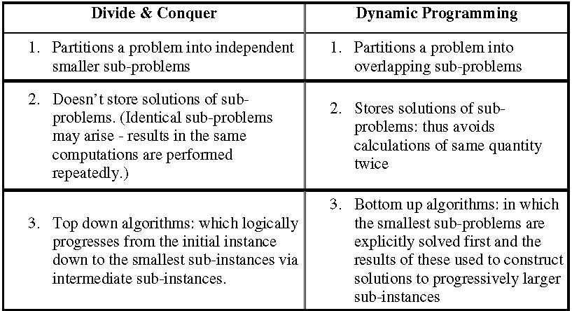
` Dynamic Programming vs.Divide & Conquer

Slide 10
` Dynamic Programming vs Greedy Method
Dynamic Programming | Greedy Method
1. Dynamic Programming is used to obtain the optimal solution. | 1. Greedy Method is also used to get the optimal solution.
2. In Dynamic Programming, we choose at each step, but the choice may depend on the solution to sub-problems. | 2. In a greedy Algorithm, we make whatever choice seems best at the moment and then solve the sub-problems arising after the choice is made.
3. It is guaranteed that Dynamic Programming will generate an optimal solution using Principle of Optimality. | 3. In Greedy Method, there is no such guarantee of getting Optimal Solution
4. Example: 0/1 Knapsack | 4. Example: Fractional Knapsack

Slide 11
Examples
0/1 Knapsack Method
Traveling sales person Problem
Optimal Binary search tree
Matrix chain multiplication
Longest Common Sequence

Slide 12
Thank You

